Slide 1
Faculty and Staff Search Training FY26
Prework

Slide 2
Overview

Slide 3
NIU Highlights
We recruit faculty to join us in NIU’s highly recognized and dynamic inclusive environment!
Highly Recognized:
R2 research-focused
Hispanic-Serving Institution (HSI)
Fostering social mobility
Community engaged
Great College to Work For
HEED (Higher Education Excellence in Diversity) and Champion Awarded
Dynamic and Inclusive:
> 100 areas of study
Centering student success
Offering …
  Flexible learning environments
  Accelerated degree paths
  Bachelor’s, Master’s, Doctoral
  Pre-professional, professional, and academic/research focused
Fostering employee success, equity, and well-being

Slide 4
NIU Grounding
We recruit faculty to join us in pursuing our vision and mission as we practice our values.
Northern Illinois University's vision is to be an engine for innovation to advance social mobility; promote personal, professional and intellectual growth; and transform the world through research, artistry, teaching and outreach.
The mission of Northern Illinois University is to empower students through educational excellence and experiential learning as we pursue knowledge, share our research and artistry, and engage communities for the benefit of the region, state, nation and world.
The values of Northern Illinois University are:
Curiosity and creativity
Equity and inclusion
Ethics and integrity
Service and stewardship
Notes:
https://www.niu.edu/about/mission.shtml

Slide 5
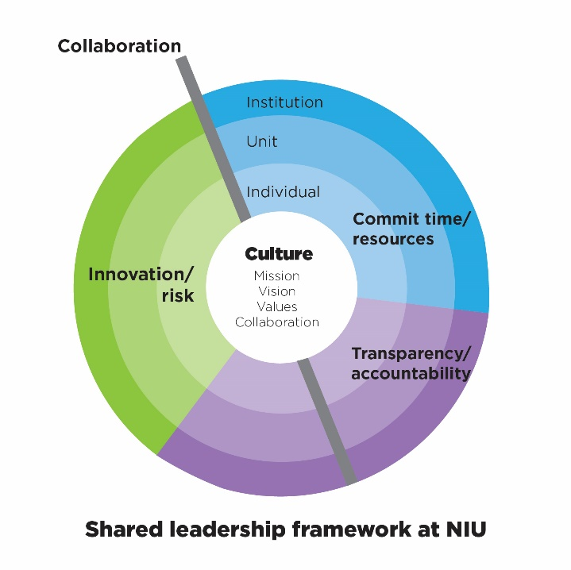
Shared Leadership
NIU has been intentional about building capacity for shared leadership by working across our university community to strengthen skills and competencies for creating shared vision and goals; building consensus; generating feedback; navigating difficult conversations; and being self-aware.
2025 University Goals

Slide 6
Faculty and Staff Searches in Context
Faculty and Staff searches support NIU’s mission, vision, values and goals.
Through shared leadership, search committees advise hiring officials in selecting a new colleague.
These colleagues contribute to NIU’s central missions, teaching and supporting the success of students, completing pioneering research and artistry, engaging with external communities, and serving the university and their professions.
University values are enacted by all participants in a search behaving with ethics and integrity in order to ensure that candidates are treated equitably and inclusively.

Slide 7
Common Features of Faculty Searches
Faculty searches have some commonalities with other searches, and also some unique elements that require particular focus in order to ensure equity. For instance:
  Whereas staff searches may happen at any time, faculty and staff searches typically happen during the academic year.
  Whereas staff searches may be local, faculty and staff searches are often national, with recruitment through professional organizations and networks.
  Candidates likely know one another professionally, and may have prior collaborating, advising, or employment relationships.
  Candidates often travel for on-campus visits from out of state.
  Stakeholders across campus meet with candidates, including at meals, throughout their visits.

Slide 8
An Overview of the Faculty and Staff Hiring Process
This process is a long-term commitment!
The faculty search itself generally takes several months, often spanning more than one semester. Staff searches typically last 60-90 days.
Searches run most smoothly with planning, including developing materials and scheduling meetings in advance.
Create Hiring
Plan
Post
Position
Screen Applicants
Conduct On-Campus Interviews
Prepare & Support New Employee
Synthesize Assessments
Request Ok & Make Offer
Form & Charge
Committee
Advertise & Recruit
Gather References

Slide 9
Inclusivity Principles

Slide 10
Key Points to Keep in Mind throughout the Search
The search committee is a collective and represents different perspectives from across the local department, college, and university.
The committee is doing the important work of hiring a new colleague, and ensuring equity throughout the stages of a search!
All roles are important and synergistic.
  We share responsibility for ensuring the ad is broadly distributed.
  We share responsibility for creating a welcoming environment.
Searches set the tone.
  Welcome and belonging should be conveyed at every step for every candidate.
  We share responsibility for ensuring processes run as smoothly.
Every piece of the process matters.
  Candidates are evaluating us, as we make our assessments of them.
  Outside perspectives offer us an opportunity to learn.

Slide 11
More About Roles and Processes in a Faculty and Staff Search

Slide 12
Roles
Division Head: The Provost authorizes faculty and staff searches, with requests made by college Deans.
Hiring Official: The hiring official has the authority to make the hiring decision for a search. For faculty and staff searches, the hiring official is the Dean, who may delegate to another (e.g., Department Chair).
Hiring Manager: The hiring manager is the staff person who provides support for the logistics of the search.
Search Committee: The search committee is advisory to the Hiring Official. Committee members help ensure robust and equitable processes throughout the recruiting, screening, and interviewing of candidates.
Human Resource Services: HRS staff act as advisors on search processes and help with all of the administrative support.

Slide 13
Hiring Plan, Charge Meeting, and Search Planning
After a faculty search is authorized, the hiring plan is completed and routed for approval by the Search Committee Chair, Department Chair, Dean, and Provost.
The Hiring Plan lists the search committee members and provides the job description and plans for advertising/recruitment.
The Hiring Official meets with the Search Committee to give them their charge before any review and evaluation of candidates begins.
The Search Committee should begin planning early for later stages of the search, including advertising, screening, and interviews.
The planning should include developing rubrics for assessing candidates in relation to job qualifications.
These rubrics should be developed prior to beginning review of candidate materials.

Slide 14
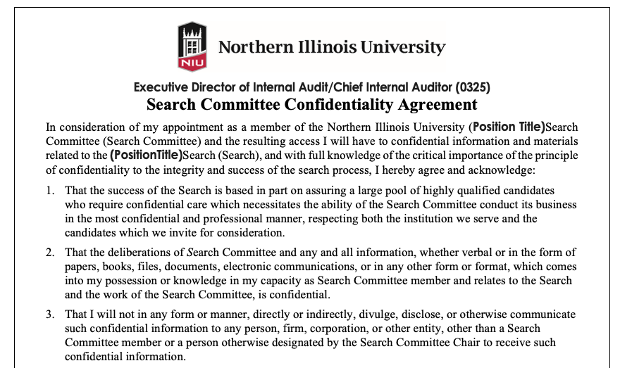
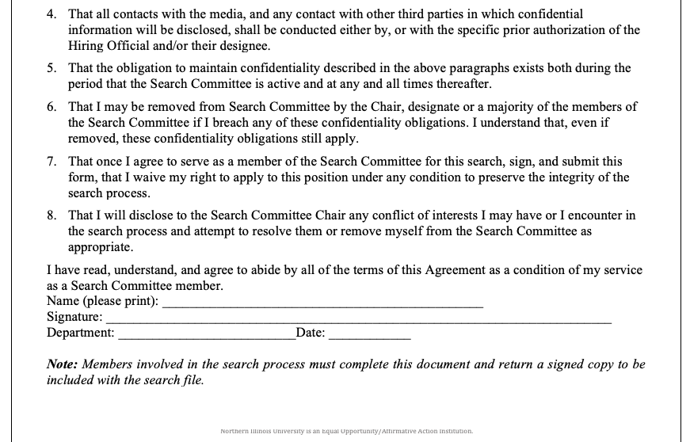
Confidentiality
Confidentiality is key to the integrity of the search process.
Candidates, committee members, and other stakeholders require confidence that materials and discussions will remain in confidence.
All committee members must read, sign, and follow a confidentiality statement.
HRS will ensure a search committee member’s confidentiality statement has been received before giving them access to applicants’ materials in PeopleAdmin.

Slide 15
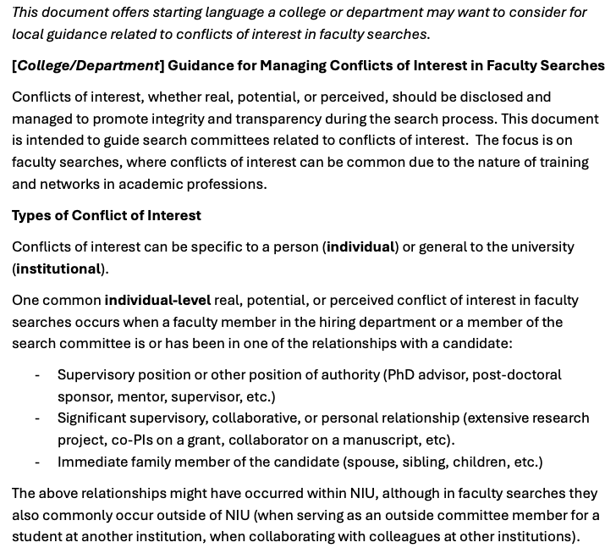
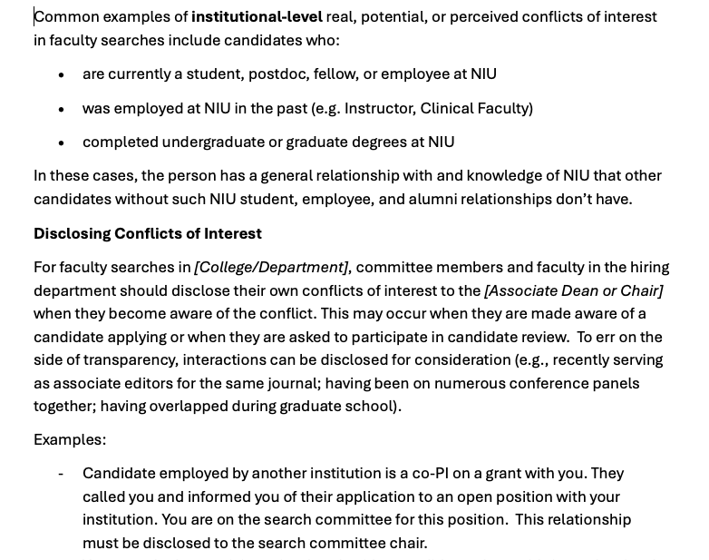
Conflicts of Interest
Disclosing and managing conflicts of interest support equity.
Departments and colleges are encouraged to consider adopting formal conflict of interest guidance.
…

Slide 16
Job Postings
For faculty and staff searches, the key components for the job posting are included in the faculty hiring plan.
Job postings include:
  Overview
  Position summary
  Essential duties and responsibilities
  Minimum required qualifications
  Additional requirements
  Preferred qualifications
  Application procedure
Evaluation of candidates should be in relation to the job posting, focusing on whether the candidates meet the required and preferred qualifications.
The application procedures should request the materials needed to make this assessment.
A key element of inclusion for consideration is ensuring that the job posting is written in a way that all qualified candidates can apply.
Including the salary range supports equity.

Slide 17
References
Searches can vary in how they gather references, such as:
Letters requested as part of the initial application.
Letters requested for finalists.
Phone calls with references completed for finalists.
At a minimum, HRS requires that all finalists for faculty and staff searches who are invited to on-campus interviews must have their references checked, and HRS must retain records of these checks.
References can be gathered before or after campus visits.
Best practice is that the hiring official discusses with the search chair and committee at the charge meeting the plan for how references will be gathered and at what timing.
When references are checked via phone call.
Notes related to the reference calls must be retained.
Equity is supported by the same people conducting reference calls using the same series of questions for each candidate.

Slide 18
References (cont.)
“Off-the-record” or informal discussions with colleagues about applicants should not occur, including because:
  Applicants would be treated differently if such discussions happen for some and not others
  Such discussions may reveal a person’s application to their current employer or to colleagues before they are ready to do so.
“Off-list” references, meaning references in addition to those submitted with an application, can be utilized only if the candidate is aware.
  Best practice for “off-list” references is to ask all candidates still in contention for the position (e.g., finalists) for additional references of the same type (e.g., a reference from a direct report, a reference from a former student).

Slide 19
Advertising and Recruitment
Advertising is a key aspect of ensuring a robust pool of qualified applicants.
HRS places ads in common outlets such as the Chronicle of Higher Education and Indeed.
A central role of the search committee in faculty and staff searches is to identify additional outlets unique to the profession where ads will be placed and to share ads in their professional networks, such as:
  Professional associations and their committees and conferences
  Social media, such as individual and organizational postings on LinkedIn
  “Outside of the box” avenues to promote equity in reaching qualified candidates
The hiring manager works with HRS to support the logistics of placing ads and retaining documentation of ads.
A Custom Landing Page for the job encapsulates the job description in a visually appealing way, and can be used as a link in sharing with networks.

Slide 20
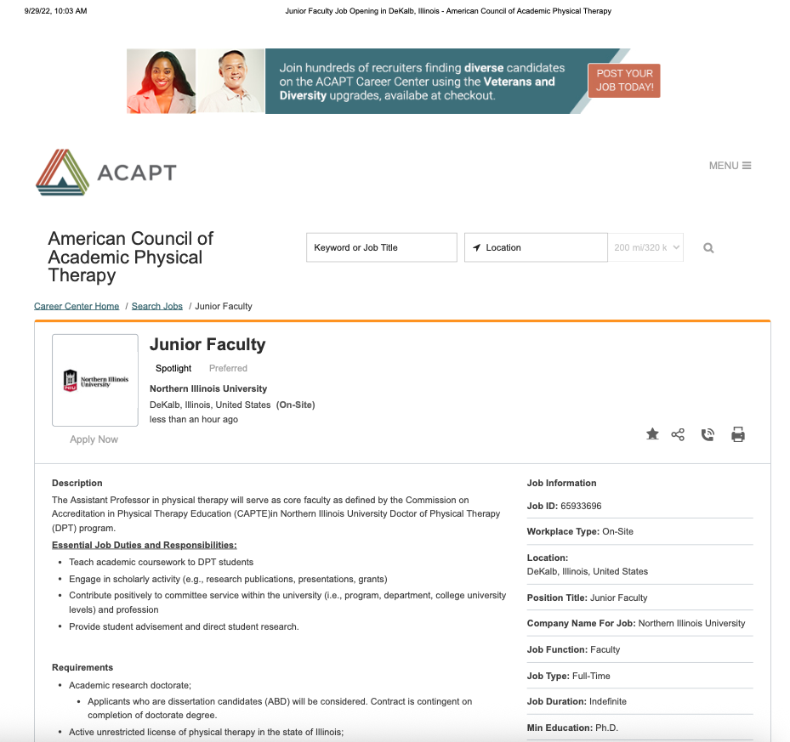
Example Ad

Slide 21
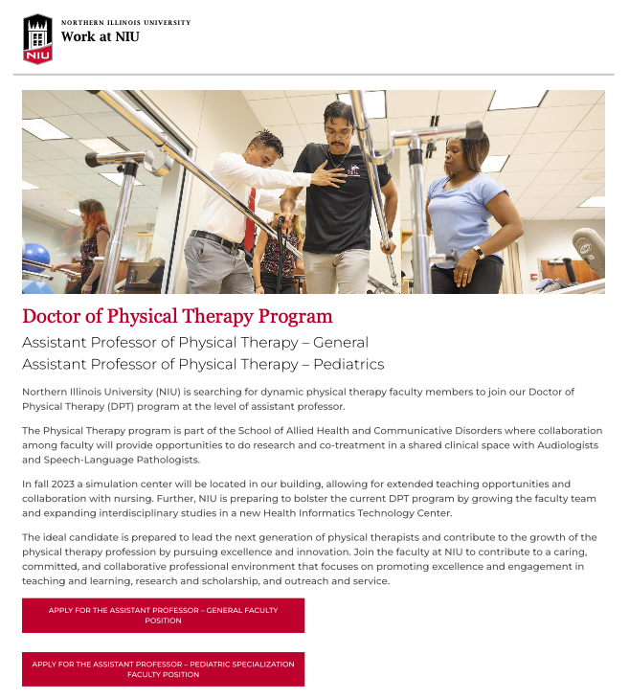
Example
Custom
Landing
Page

Slide 22
Applicant Materials
After completing training and documentation (e.g., confidentiality form), committee members have access to applicant materials in PeopleAdmin.
Hiring managers sometimes download the core application materials from PeopleAdmin and place in a Sharepoint subfolder for the search (e.g., cover letter, CV, statements).
In whatever storage system, committee members adhere to the confidentiality agreement that they have signed, including in relation to careful protection of these materials.
Applications can be reviewed and screening interviews may occur before the priority review date.
Decisions regarding which candidates to bring to campus occur after all applications received by the priority review date have been fully considered following the same procedures.
The Hiring Manager coordinates with HRS and assists the committee to ensure that records are appropriately retained.

Slide 23
Screening Process
The committee screens application materials for required and preferred qualifications.
The same screening rubric is used for each candidate.
Depending on the number of qualified candidates, the committee may use screening interviews to develop a short list.
For some recruitments, screening interviews are often conducted via Zoom or Teams.
An interview script should be developed before the first screening interview.
The same screening interview questions should be used for each candidate.

Slide 24
Developing a Rubric and Ground Rules
Agree upon ground rules for evaluating candidates, including how you will vote.
  Ensure you know the hiring official’s preferences for how they would like to receive committee members’ assessments
    Will the hiring official make the decision or delegate the decision for determining who will be invited to on-campus interviews?
    Does the hiring official want summaries of each semi-finalist and/or assessments of each of their acceptability and/or rank orderings and/or something else?
Schedule early when the committee will meet, including for:
  Discussion of assessments of their screening of submitted materials.
  Screening interviews (if used/needed).
  On campus visits.
Agree on job-related evaluation criteria
  Develop a rubric that will be used by all committee members (i.e., checklist, rating form, spreadsheet, etc.)
  Agree on how committee members’ evaluations will be shared and summarized.
Agree on rules of discussion and how to handle disagreement.
  Avoid comments (either spoken or in written notes) that are not job related.
  If bias is noticed, speak out and redirect the conversation.
  Be aware of the possibility of your own biases.

Slide 25
Including score justifications
Think through rubrics for materials review, screening interviews, and on-campus visits.
  What can be best assessed in each context?
Focus on the candidate’s materials and interview responses as they relate to the qualifications.
  Don’t use general terms like “lack of fit,” be specific.
  Ask others to clarify where needed, and be open to doing so yourself.
Point to evidence justifying why you scored the way you did (and be open to how doing so may lead you to revise your scores).
Recognize that each committee member brings unique perspectives.
  Be open to what someone else may identify that you may have missed.
Don’t discuss aspects of a person’s characteristics, personality, or statements that don’t relate to the job qualifications.

Slide 26
Interview Questions
Refer to the “Sample Interview Questions” document for examples that can be used or adapted for your search.
Use the same set of questions in the same order for all candidates.
  Aim to have the same committee member ask the same questions each time.
  Plan any follow-up questions in advance.
  Use specialized follow-up questions only for essential clarification.
Ask single, clear, and concise questions
  Avoid asking two things at once. Separate in two or focus on one.
Consider the length of time you have, and likely length of responses.
  Let candidates know at the beginning the number of questions and approximate expected response length.
  Give them feedback if they’re saying a lot or a little.
    “Just a reminder that we have four more questions, we appreciate what you’re sharing, yet somewhat shorter responses will give you a chance to answer all of our questions.”
    “Remember we have time for up to 5 minutes for each response. Feel free to share a bit more.”
  Give them feedback at the mid-way point as well, especially if they’re over or under time.

Slide 27
Questions that cannot be asked
(directly or indirectly)
Citizenship/visa status
Marital status
Parent status
Age
Race
Disability
Religion
Arrest record

Slide 28
On-Campus Visits
Remember the candidate is evaluating us, while we are evaluating them
  Aim to show our best from start to finish
Learn who is responsible for what logistical pieces in your department
  Search chair/committee, hiring manager, office manager
Be sensitive to teaching, family, personal, research needs when scheduling
  Candidates vary in preferences for departure/arrival times and weekday/weekend travel, etc.
Aim to have a contact person available throughout their travel and visit if any disruptions or emergencies come up
Aim to have a host to walk candidates from meeting to meeting, and keep their schedule on time
Schedule meetings with campus stakeholders for each candidate
  Aim for same types and order of meetings for each candidate
  College/department leaders (e.g., Dean, Associate Dean, Department Chair)
  Human Resource Services to cover benefits and employment questions
  As appropriate for role CITL (teaching/learning), RIPS (research, artistry, scholarship), etc.
Treat internal and external candidates the same
  Be sure internal candidates have hosts, contacts, and meetings, even with people and places they know

Slide 29
On-Campus Visits (cont.)
Ask about dietary restrictions and accommodations
  Offer a range of restaurants and dine-in for meals
  Consider mobility when scheduling (transport among meetings, time standing or sitting)
Include breaks in the schedule
  Time to visit restroom, for water, for a breather
  Ask candidate if they need breaks or private space at any time of day
Ask candidates who they may want to meet with on campus, including:
  Centers and institutes
  Other colleges/departments
Ask for feedback from stakeholders in the same way for every candidate
  Printed survey, Qualtrics survey, etc.
Provide materials in the same way for every candidate (internal and external)
  e.g., attach the job description and their CV to meeting invites

