Slide 1
Search Committee Charge Meeting
Division of Human Resource Services www.niu.edu/hrs

Slide 2
What we’ll cover today
NIU grounding
Search/Recruitment process
Your role as a search committee member
Review, evaluate, and interview best practices
Access to applications
Questions and Answers

Slide 3
Charge Meeting
NIU Grounding

Slide 4
Charge Meeting
We recruit candidates that align with our mission and values
Northern Illinois University's vision is to be an engine for innovation to advance social mobility; promote personal, professional and intellectual growth; and transform the world through research, artistry, teaching and outreach. | The mission of Northern Illinois University is to empower students through educational excellence and experiential learning as we pursue knowledge, share our research and artistry, and engage communities for the benefit of the region, state, nation and world. | The values of Northern Illinois University are:​ Curiosity and creativity​ Equity and inclusion​ Ethics and integrity​ Service and stewardship

Slide 5
Charge Meeting
Search/Recruitment Process

Slide 6
Charge Meeting
Search/Recruitment Process
We are here
Pre-recruitment activity
Establish department needs.
Recruitment plan/strategy
Selection of the search team/committee.
Posting and advertising
Identification of the recruitment plan.
Search committee charge meeting
Screening of applicants
Develop a job description.
Timeline development.
Placement of advertisements, internal/external.
Review of search team/committee role and best practices.
Train how to access applications.
Develop/ or review applicants against the rubric to determine interview selections.
Interviews
Create questions to determine if skills match the needs of the job.
Review and recommendations
HR or the hiring manager will conduct reference calls.
Discharging of committee
Once a hire has been made, the committee will be informed and discharged.
Offer and hiring
Onboarding
May be virtual or on site
Return any materials, notes may be discarded
HR or Hiring Manager make offer.
Employee begins onboarding after acceptance.
HR paperwork and learning begins on NIU and the new job.

Slide 7
Charge Meeting
Your role as a search committee member

Slide 8
Charge Meeting
About the search committee
The search committee is a collective and represents different perspectives from across the local department, college, and university.​
All roles are important and synergistic​
We share responsibility for ensuring the ad is broadly distributed​.
We share responsibility for ensuring each candidate is treated equitably​.
Searches set the tone​
A sense of welcome and belonging should be conveyed at every step​.
We share responsibility for ensuring processes run as smoothly​.
Every piece of the process matters​
Candidates are evaluating us, as we make our assessments of them​.
Outside perspectives offer us an opportunity to learn​.

Slide 9
Charge Meeting
Roles within a search process
Division Head: The Vice President or division leader authorizes searches, with requests made by unit leaders.​
Hiring Official: The hiring official has the authority to make the hiring decision for a search. For faculty searches, the hiring official is the Dean, who may delegate to another (e.g., Department Chair).​ For staff, it is the division leader, in coordination with the unit leader.
Hiring Manager: The hiring manager is the staff person who provides support for the logistics of the search and is ultimately responsible for supervising the employee. ​
(Civil Service Only) Subject Matter Expert: A person identified outside of the search process, who has knowledge of the job expectations and requirements that helps screen the applications to ensure they have met the minimum qualifications.
Human Resource Services: Subject matter experts on recruitment and recruitment processes. Also, provide all administrative support for the search.
Search Committee: The search committee is advisory to the Hiring Official. Committee members help ensure robust and equitable processes throughout the recruiting, screening, and interviewing of candidates.

Slide 10
Charge Meeting
Primary roles of a search committee member
Defining the Evaluation Criteria
Develop a deep understanding of the qualifications for the role.
Establishes evaluation criteria that focus on the qualifications and needs of the position.
Screening and Evaluation
Reviews applications and selects candidates for interviews.
Evaluates candidates based on established criteria, ensuring fairness and consistency.
Interviewing Candidates
Conducts interviews, often including presentations or campus visits.
Engages with stakeholders (faculty, staff, students) during the interview process.
Recommendation
Provides a ranked list or summary of the strengths and weaknesses of the top candidates.
Depending on the charge, recommendations may be made to the hiring authority (e.g., Dean, Provost, President).
Ensuring Equity and Compliance
Follows institutional policies and legal guidelines to ensure a fair and unbiased process.
Confidentiality
Maintains strict confidentiality throughout the process to protect candidates and the integrity of the search.

Slide 11
Charge Meeting
Applicant materials
After completing training and documentation (e.g., confidentiality form), committee members have access to applicant materials in PeopleAdmin. ​
Human Resources will provide regular check-ins with the Search Chair and Unit Hiring Manager to see what support is needed with the search and to collect required documentation along the way, which will be stored in PeopleAdmin.
PeopleAdmin is the official repository where documents are maintained. The committee members adhere to the confidentiality agreement that they have signed, including careful protection of these materials.​
For non-civil service positions, applications can be reviewed, and screening interviews may occur before the priority review date.​
Decisions regarding which candidates to bring to campus occur after all applications received by the priority review date have been fully considered, following the same procedures.​

Slide 12
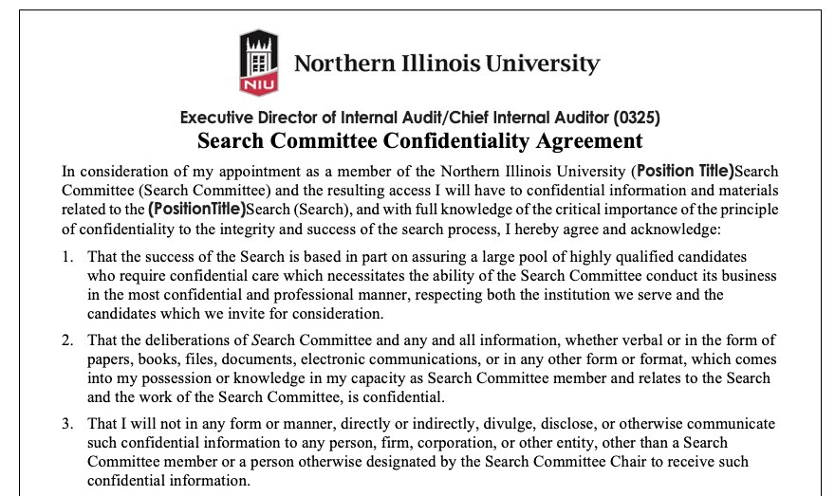
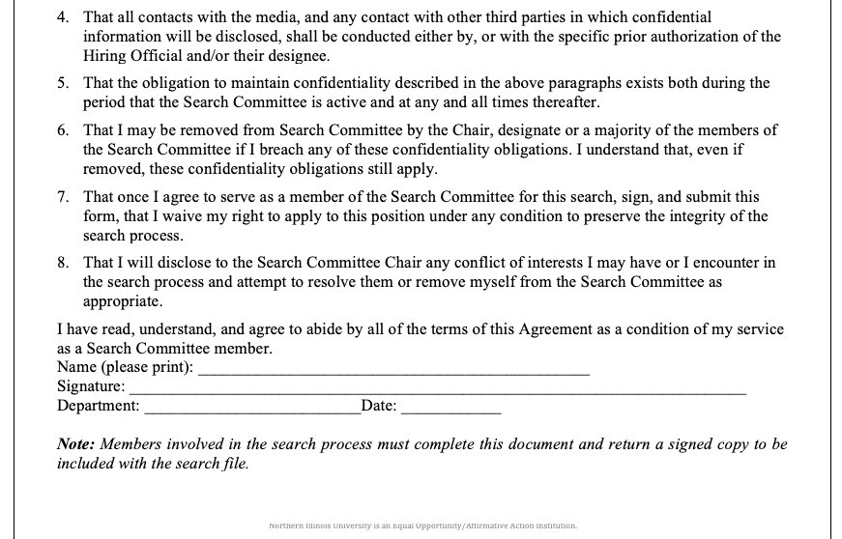
Charge Meeting
Confidentiality is key to the integrity of the search process.​

Slide 13
Charge Meeting
Review, evaluate, and interview best practices

Slide 14
Charge Meeting
Screening process
The committee screens application materials for required and preferred qualifications.​ (For Civil Service, HRS does this.)
The same screening rubric is used for each candidate.​
Depending on the number of qualified candidates, the committee may use screening interviews to develop a short list. ​
For some searches, screening interviews are often conducted via Zoom or Teams.​
An interview script should be developed before the first screening interview.​
The same screening interview questions should be used for each candidate.

Slide 15
Charge Meeting
❌ Topics and Questions to Avoid
✅ Best Practices for Interviewers
1. Race, Ethnicity, or National Origin
Illegal: “Where were you born?” or “What’s your accent from?”
Legal Alternative: “Are you legally authorized to work in the U.S.?”
2. Religion
Illegal: “Do you observe religious holidays?” or “Which church do you attend?”
Legal Alternative: “Are you available to work the required schedule?”
3. Age
Illegal: “How old are you?” or “When did you graduate high school?”
Legal Alternative: “Are you over 18?” (if age is a job requirement)
4. Gender and Sexual Orientation
Illegal: “Are you male or female?” or “Do you have a boyfriend/girlfriend?”
Legal Alternative: Focus on job qualifications and availability.
5. Disability
Illegal: “Do you have a disability?” or “Have you ever been on disability leave?”
Legal Alternative: “Can you perform the essential job functions with or without reasonable accommodations?”
6. Pregnancy and Family Status
Illegal: “Are you pregnant?” or “Do you plan to have children?”
Legal Alternative: “Can you meet the job’s attendance and scheduling requirements?”
7. Citizenship
Illegal: “Are you a U.S. citizen?”
Legal Alternative: “Are you legally authorized to work in the U.S.?”
8. Salary History
Illegal in many states: “What was your previous salary?”
Legal Alternative: “What are your salary expectations?”
9. Criminal History
Illegal: “Have you ever been arrested?”
Legal Alternative: Focus on job qualifications and availability.
1. Use Structured, Skills-Based Interviews
Focus on job-related competencies and qualifications.
2. Train Interviewers
Ensure all hiring personnel understand what questions are off-limits and why.
3. Update Interview Question Banks
Regularly review and revise questions to stay compliant with current laws.
4. Provide Clear Job Descriptions
Clearly define essential duties and requirements to guide appropriate questioning.
5. Document Interviews
Keep records of interview questions and responses to ensure transparency and consistency.
6. Create a welcoming and inclusive environment
Showcase the best assets and benefits of working at NIU.

Slide 16
Charge Meeting
Developing a rubric and ground rules
Agree upon ground rules for evaluating candidates, including how you will vote. ​
Ensure you know the hiring official’s preferences for how they would like to receive committee members’ assessments.​
Will the hiring official make the decision or delegate the decision for determining who will be invited to an interview? ​
Does the hiring official want summaries of each semi-finalist and/or assessments of each of their acceptability and/or rank orderings and/or something else? ​
Schedule early when the committee will meet, including for:​
Discussion of assessments of their screening of submitted materials.​
Screening interviews (if used/needed).​
On campus visits.​
Agree on job-related evaluation criteria.​
Develop a rubric that will be used by all committee members (i.e., checklist, rating form, spreadsheet, etc.) ​
Agree on how committee members’ evaluations will be shared and summarized.​
Agree on the rules of discussion and how to handle disagreements. ​
Avoid comments (either spoken or in written notes) that are not job-related. ​
If bias or potential discrimination is noticed, speak out and redirect the conversation. ​
Be aware of the possibility of your own biases. ​

Slide 17
Charge Meeting
Let’s pause and look at the job description now.

Slide 18
Charge Meeting
Evaluation rubric (example)
​ | Excellent ​ (4)​ | Good ​ (3)​ | Satisfactory ​ (2)​ | Needs Improvement ​ (1)​
Academic Record​ | All degrees from prestigious universities​ | Graduate degree from prestigious university​ | Undergraduate degree from prestigious university​ | Universities of degrees of questionable/​ unknown quality​
Publication Record​ | Numerous publications in top-tier journals​ | Mostly top-tier publications, but not a steady stream​ | Some publications in niche journals​ | Few publications, mostly in obscure journals​
Research Focus​ | Working in high-visibility areas in the discipline that fit nicely with the department​ | Some disciplinary visibility, and well aligned with department’s current focus​ | Works in a specialized area, marginally aligned with department​ | Research in an emerging area, unclear how well it fits with the department​
Clinical Expertise​ | Clearly has the credentials we need​ | Documentation of credentials are unclear​ | Has credentials from another country​ | Didn’t supply any evidence of credentials​

Slide 19
Charge Meeting
Scoring justifications
Think through rubrics for materials review, screening interviews, and on-campus visits.​
What can be best assessed in each context?​
Focus on the candidate’s materials and interview responses as they relate to the qualifications.​
Don’t use general terms like “lack of fit,” be specific.​
Ask others to clarify where needed, and be open to doing so yourself.​
Point to evidence justifying why you scored the way you did (doing so may lead you to revise your scores).​
Recognize that each committee member brings unique perspectives.​
Be open to what someone else may identify that you may have missed.​
Don’t discuss aspects of a person’s characteristics, personality, or statements that don’t relate to the job qualifications.

Slide 20
Interview Questions
Interview questions
Use the same set of questions in the same order for all candidates.​
Aim to have the same committee member ask the same questions each time.​
Plan any follow-up questions in advance. ​
Use specialized follow-up questions only for essential clarification.​
Ask single, clear, and concise questions​
Avoid asking two things at once. Separate in two or focus on one.​
Consider the length of time you have, and likely length of responses.​
Let candidates know at the beginning the number of questions and approximate expected response length.​
Give them feedback if they’re saying a lot or a little.​
“Just a reminder that we have X more questions, we appreciate what you’re sharing, yet somewhat shorter responses will give you a chance to answer all of our questions.”​
“Remember we have time for up to X minutes for each response. Feel free to share a bit more.”​
Give them feedback at the mid-way point as well, especially if they’re over or under time.

Slide 21
Charge Meeting
Probing or follow up questions
You must stick to a consistent line of questioning for candidates; however, if a candidate provides information in an answer that needs more investigation, ask for it!

Slide 22
Charge Meeting
Interview modalities
Pre-screening
Typically done virtually or by phone.
Use when you have a large number of applicants
First round screening
Can be done in lieu of pre-screening.
Use when you have 5-10 applicants as a way to narrow to 2-3 finalists.
On campus visits
On-campus visits should be reserved for finalists.
Follow-up interviews
Useful when needed to break a tie between two candidates.
Can be useful if a key stakeholder or group was not available for interview during an on-campus visit

Slide 23
Charge Meeting
Pro tips for on campus interviews
Two-way evaluations
Remember, the candidate is evaluating NIU as much as we are evaluating them.
Decide on a contact person for the candidate(s)
Responsible for coordinating travel, accommodations, meals, etc.
The point of contact on campus should serve as a guide for the candidate during their visit.
On campus visits to the areas of campus
Consider groups or departments that may be impacted by the work of the candidate(s). Arrange forums or meetings with them.
Arrange for HRS to meet with the candidate to review benefits.
Consider other centers/institutes to meet with.
Ask for feedback
Arrange for the collection of feedback from stakeholders who interact with or meet with the candidate.
Remember to provide the REDACTED information of the candidate to stakeholders before meeting with the candidate.

Slide 24
Charge Meeting
Additional tips for interview best practices
Do not record the interviews.
There are specific requirements of notification and retention of video or audio recordings.
If a search member cannot attend one meeting, that may not preclude them from being on the search; however, they may be disadvantaged when discussing the candidates with the rest of the search committee.
Do not conduct your reference checks.
The hiring official or HRS will perform these checks.
This also includes Googling the candidate ahead of time.
Determine if you have a conflict of interest.
A family member or close colleague is an applicant.
Other ethical considerations.

Slide 25
Charge Meeting
Access to applications

Slide 26
Charge Meeting
Logging into PeopleAdmin
Visit: https://employment.niu.edu/hr/sessions/new
Click on “Click here to login to PeopleAdmin for Single Sign-On”.

Slide 27
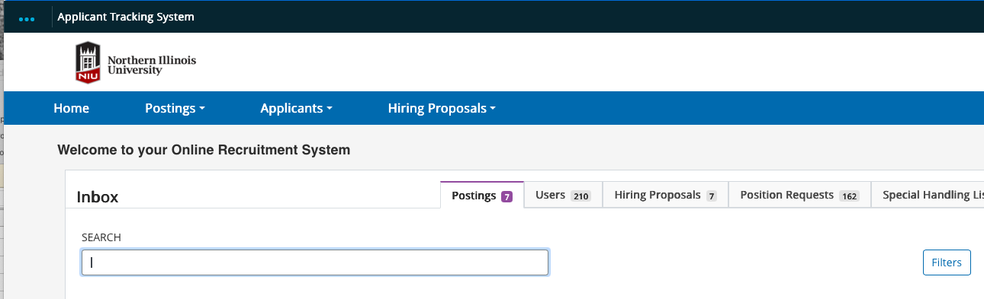
Charge Meeting
Logging into PeopleAdmin
Once logged in, scroll to the top left corner of the screen next to the three dots to ensure that your current screen says, "Applicant Tracking System." If it doesn't, click on the three dots and select it from the drop-down list

Slide 28
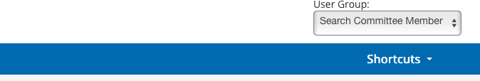
Charge Meeting
Accessing applications
Next, scroll over to the top right-hand corner of the screen to the drop-down box for "User Group" and make sure that the "Search Committee Member" user group has been selected

Slide 29
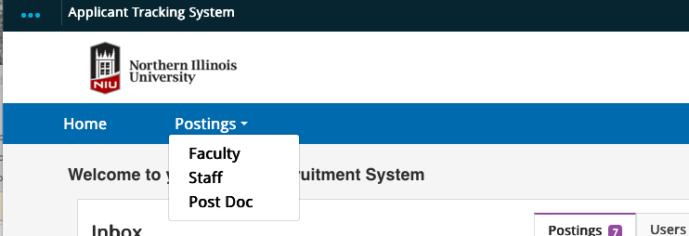
Charge Meeting
Accessing applications
Next, click on “Postings” in the blue ribbon and depending on the classification of the position, select "Faculty" or “Staff” from the dropdown list

Slide 30
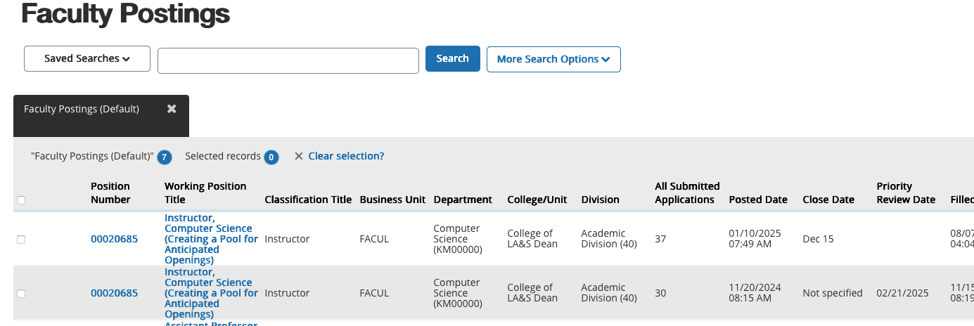
Charge Meeting
Accessing applications

Slide 31
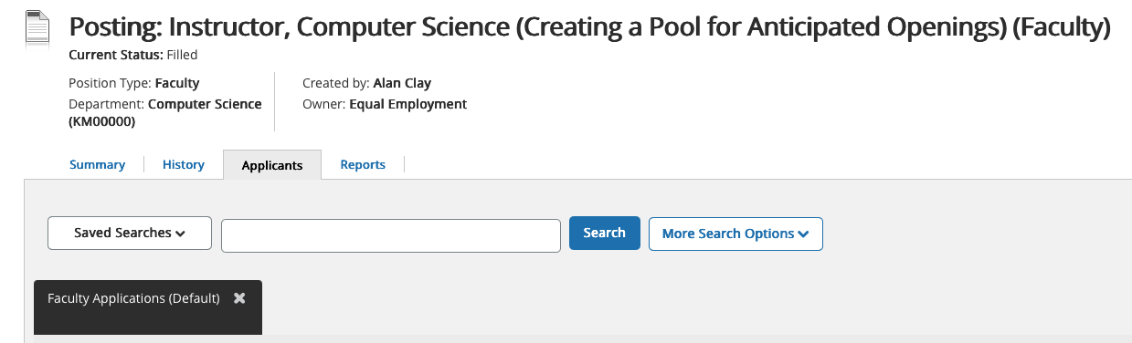
Charge Meeting
Accessing applications
Review the "Summary" page first to review the details of the position, including the qualifications, which you will use to evaluate the applicants.
Next, click on the "Applicants" tab to begin reviewing each applicant.

Slide 32
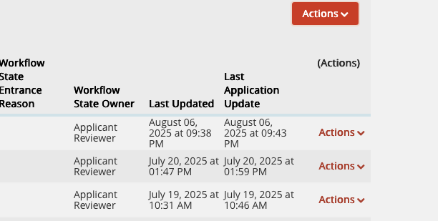
Charge Meeting
Evaluating applicants (not all searches)
Hover over the orange “Actions” button and select “Evaluate Applicants”

Slide 33

Thank you!
Questions & Answers

