Slide 1
State of Illinois Paid Leave Benefit
Presentation for Supervisors March 6, 2024

Slide 2
Agenda
Paid Leave for all Workers (PLFAW) background.
Overview of new benefit at NIU.
Decision points for NIU’s policy.
Process for approving leave.
Process for reporting leave.
Next steps for supervisors to prepare for implementation.
Questions & discussion.

Slide 3
PLFAW background
Effective January 1, 2024; NIU implemented March 31, 2024.
Law provides employers with 90-day wait period for all newly eligible employees.
Law intended to provide all employees up to 40 hours of paid leave.
Employees can use paid leave for any reason, and the university may not require workers to provide a basis for that time off request.

Slide 4
Overview of the new benefit at NIU
At NIU, eligible employment groups are:
Faculty (both full-time and part-time full faculty and instructors)
Civil Service (all full-time and part-time, status and non-status/extra help)
SPS (full-time and part-time)
Graduate Assistants
All eligible employment groups receive 20 hours from March 31-June 30, 2024, and 40 hours every July 1 thereafter.
The benefit provides no accrual and is not compensable after separation.

Slide 5
Decision points for NIU’s policy
ISU, WIU, EIU adopting a similar approach to NIU.
The benefit may be subject to bargaining.
The IL Department of Labor provided additional flexibility from the original law but came with conditions. Some considerations:
Utilizing existing vacation benefits
Benefit would become compensable upon separation.
Vacation policy would need to be modified to account for new regulations.
Could present challenges when faced with employee issues regarding absenteeism.
State of Illinois Paid Leave Benefit usage cannot be used in performance evaluations nor absences subject to discipline.
Prorate benefits for part-time employees and/or new hires
Presented challenges with job changes, transfers and separations (951 rehires since July 2023) and with mid-year employment changes (192 FTE changes since July 2023).
Accrual versus front loading
When accrual method is implemented, unused time rolls over from year to year.
If employee separates and returns to work in the same year, balance is reinstated, but could be on different accrual schedule.

Slide 6

Process for approving leave
Employees can request time off verbally or in writing.
Employees must follow departmental notification procedures for time away from work.
Employees must arrange leave requests with consideration to university's core operational needs.
If need for leave time is foreseeable, employees must provide as much notice as possible, but at least 7 calendar days.
If the need for leave time is not foreseeable, employees must provide as much notice as reasonably possible.

Slide 7
Process for approving leave
Supervisors are expected to approve time off requests to the greatest extent possible while ensuring operational needs are met.
Supervisors must keep record of all approvals and denials.
Supervisors will be required to sign off on hourly timesheets and salaried benefit usage forms when usage occurs.

Slide 8
Process for approving leave
Supervisors can deny an employee's State of Illinois Paid Leave benefit request under the following two conditions:
Condition #1
Condition #2
The employee has been notified in writing when such leave requests will be denied.
This can be done at the division, department or supervisor level.
When developing documentation consider operational necessity dates, critical events and minimum staffing levels
Can be subject to change with written notice to employees as soon as practical.
Proactively communicate this information to your team (include in departmental procedures/ handbook and onboarding processes)
The limited circumstances for which leave may be denied are done to meet the core operational needs of the unit. Supervisors should consider the following:
Whether the unit provides a need or service critical to the health, safety or welfare of the campus community.
Whether similarly situated employees are treated the same for the purposes of reviewing, approving and denying paid leave.
Whether granting leave during a particular time-period would significantly impact the business operations due to the employer's size.
Whether the employee has adequate opportunity to use all paid leave time they are entitled to over a 12-month period.

Slide 9
Process for approving leave
If a supervisor denies an employee's State of Illinois Paid Leave benefit request:
They must do so in writing (communication that is or can be printed).
Email, text message, Teams instant message.
Requests cannot be denied based on non-compliance with foreseeability notice requirements alone.
Employees cannot be required to produce documentation, give a reason to justify the need for leave, or find a replacement to cover absences when using State of Illinois Paid Leave benefits.

Slide 10
Process for reporting leave
Employees will be required to report State of Illinois Paid Leave benefits on their hourly timesheet or salaried benefit usage form.
Hourly timesheets and salaried benefit usage reports will be updated prior to March 31 implementation date.
Will also include an update for Huskies Give Back.
Usage should be reported to the nearest quarter hour.
Employees will be able to see available leave balances on pay advices.

Slide 11
Process for reporting leave
Supervisors will be responsible for signing off on hourly timesheets and/or salaried benefit usage forms for time that was approved and utilized.
Salaried employees (graduate assistants and part-time faculty) who are eligible for State of Illinois Paid Leave benefits, but not eligible for vacation and/or sick benefits, will only be required to complete salaried benefit usage forms when leave time was approved and utilized.
This exception is in place until online time reporting is available.
HR is working to identify this population separately on the benefit usage summaries.

Slide 12
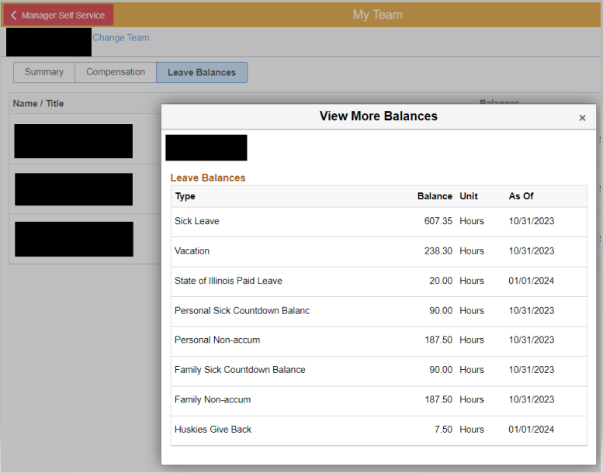
Process for reporting leave
Updates are coming soon
to Manager Self Service
in MyNIU HR that will allow
supervisors to see
compensation and leave
balances for their employees.
*more information to come once available

Slide 13
Next steps for supervisors
Communicate departmental procedures for requesting time away from work to employees newly eligible for paid level benefits.
Determine if you have specific operational needs that will require you to document dates, events or minimum staffing levels to your team (required to deny State of Illinois Paid Leave benefits requests).
Re-familiarize yourself with the Manager Self-Service module in MyNIU HR.
Resources available on the HR website: go.niu.edu/manager-ss.

Slide 14
Thank you!
Questions & Discussion

